Slide 1

Cybersecurity recruitment in africa
QuarterCon
Cyber in Africa
@CyberInAfrica
Differences in recruiting cybersecurity talent in Africa vs silicon valley, and what we can do about it.

Slide 2

Engagement : Cybersecurity recruitment in africa
Introduction: /whoami
Recruiting in Silicon Valley: How high-tech does it
Recruiting in Africa: How we do it
How we can improve: Lessons learnt from the best
Summary

Slide 3
Disclaimer
Opinions expressed during this talk are my own and do not represent the opinions of my employers, past, present and future nor do they represent the opinions of my business, present or future.
Advice given is subjective to my own experience in Information security recruiting. My opinions are not based as a defacto authority on the matter, but merely first hand account.
Take all that I say onboard, 1 thing of what I say onboard, or none, I am happy!
Notes:
TL:DR These are my opinions

Slide 4
Cybersecurity recruitment in africa
Introduction
/whoami /ipconfig all

Slide 5
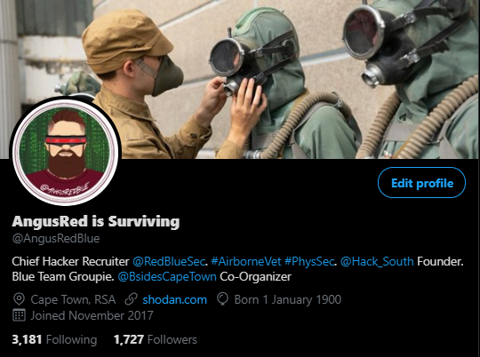
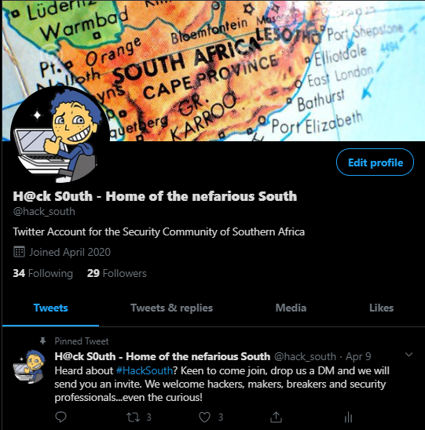

Introduction ~$ career/ ls -la
Charles H Wroth (google me!)
*6 Years: Former British Airborne (3 PARA) UK
*6 Years :High Risk Security Advisor (PhysSec)
-O&G (Mozambique)
-Mining and Minerals (Sierra Leone, Mozambique)
-Anti-Piracy (Rovuma Basin)
-HECPO (Iraq)
-Coxswain (Mozambique)
-Team Medic
*3 Years: Technical Security Recruiter
-Technically advanced security hiring (USA, UK, RSA)
-B Sides Cape Town Co-Organizer (Logistics)
-Hack South Founder/Root
-Working to become a DFIR Consultant
-Noob level CTF’er aka BASE64 Decoder
Notes:
What you do for a living.
TL:DR I have been a Technical Security Recruiter for 3.5 years, servicing Silicon Valley Startups, Consulting companies and the Defense sector, mostly in the USA, UK and RSA. And to think, once upon a time I was a Lance Corporal in the British Military

Slide 6
Cybersecurity recruitment in africa
Recruiting in Silicon Valley How high-tech does it

Slide 7
Recruiting in Silicon Valley How high-tech does it
Compensation
Valley Benefits
Qualifying Factors
Rate of Hire
Interview Cycle
Notes:
Compensation
Silicon Valley has some of the highest compensation in tech and security
Valley Benefits
Unlimited PTO
Flexi Hours
WFH/Remote
RSU/PSU Stock
Con support
Research time
Educational Reimbursement
Child Care
Health/Dental/Vision
Catering, Snacks, La Croix
Qualifications and Experience
Candidates largely judged on track record with companies and skills
Rate of Hire (Pipeline Velocity)
7-21 Days
Expadited process for top talent
Minimum background checking
Let work speak for itself
Multiple opportunities simultaneously
Interview Cycle
Recruiter Phone Screen
Tech Lead/Manager
Team Member
Onsite (Panels)
CISO
CTO
Directors
Founders
Finish with Recruiter

Slide 8
Cybersecurity recruitment in africa
Recruiting in Africa
How we do it

Slide 9

Recruiting In Africa How we do it
Compensation
Benefits
Qualifications and Experience
Rate of Hire (Pipeline Velocity)
Lack of trust hiring
Interview Cycle
Notes:
Compensation
Dev < Security (Development tends to be the highest earning job, as opposed to Security)
Dev centric Security engineering (Often security engineering is a function of Dev/DevOps)
Benefits
Minimal in many occasions
Limited educational reimbursement
Lack of training funding
Qualifications and Experience
CERTs define someones ability, not their experience.
Over substantiating of experience
HR Driven and validated recruiting, not those in the know.
Rate of Hire (Pipeline Velocity)
Often slow and stagnated
30+ Days
Corporate due process induces delays
Lack of trust hiring
Background Checks
Extensive due process
Command decision delays
Compensation verification (Payslip demanded)
Interview Cycle
Manager/Lead
Other managers
Team Member
Onsite (Panels)
Technical Screening
CISO
Directors
Background Screening
-Crim/Fraud
-Payslips
-3+ references

Slide 10
Cybersecurity recruitment in africa
How we can improve?
Lessons learnt from the best

Slide 11
How we can improve Lessons learnt from the best
Compensation
Pace of Hire
Trust
Grassroot based recruiting
Bring sexy back
Retaining talent
Partnered Recruiting
Notes:
Compensation Recognise the shortage of Security Talent, and compensate accordingly
Pace of Hire
Cant compete on comp? Compete on pace of hire! Steady pace of hire instils confidence in your company.
Trust
Try to be more trustworthy of your potential new hire. By requesting extensive background checks, requesting payslips you are LITERALLY starting a offer/hire stage portraying a definitive lack of trust.
Grassroot based recruiting
Recruit through training programs and internships.
Many companies in Africa, esp in Security centric businesses have done this with great effectiveness and have ensured a steady stream of valued candidates.
Bring sexy back
Get involved with the community, get involved with your local B Sides, get your brand out there through sponsorship, T Shirts and swag. People remember the name, and meeting people will ensure a stready register of potential candidates in the next year.
Retaining Talent
Africa fails at this. We lose so many good people to the USA, UK and EU. By supporting our employees, investing in their education, we invest in the future, and improve the odds of their future being with your company. Undoubtably, people at the top of the security food chain will always consider.
Understandably political and economic climates also play a big part. Why work for a third of the money, in a country that has sky rocketing inflation, intermittent electricity, unstable internet connections when you can earn double with none of the hassle. This is a bigger problem, but sadly not one us mere mortals can resolve.
Partnered Recruiting
By selecting a quality based recruitment partner/agency, as opposed to a quantity based recruiting partner, that specializes in a field, like security, you will get a higher quality candidate, more befitting of a position, and reduce risk of internal interview burnout. Why get 10 mediocre resumes a week, when 1-2 a week, of the right candidate works better.

Slide 12
Cybersecurity recruitment in africa
Things to remember
Summary

Slide 13
Things to remember Summary
Choose the right recruiting partner
Retain your talent
Learn from the valley
Grassroot your pipeline
Community driven branding
Notes:
Recruiting Partner Ask around, see what your recruiter is up to. Ensure they understand that which you expect them to recruit. Do they speak the language, are they going to add value, what will quality look like. These are the questions you should be asking yourself.
Retain your talent
We cant compete on what is going on at a national level, in economic climate and politics, but we can compete on how we invest in our talent, and how we nurture their careers. Learn from the valley
Yes, often compensation is hugely inflated in the valley, but that is usually due to the adverse supply vs the huge demand for high tech experienced talent. Compete on factors that you can, like educational reimbursement, on pace of hire, on personal research. Form trust based recruiting, and to counter that, learn to fail fast, and fire fast. Grassroot your pipeline
Get creative about hiring. Host training, earmark the top students, offer them internships, offer something of value, whether paid or bursary, it is the best way to ensure a steady stream of candidates year after year.
Community driven branding
Get your brand out there, in the right circles, in your target audience. Get involved in your local B Sides, DC meetups, Hackerspaces/Makerspaces. Recognition of your brand, in your target audience will hugely help in the first hurdle during hiring, as you have sold the candidate on the company already.

Slide 14
Cybersecurity recruitment in africa
Questions!
Speak now or forever hold your peace

Slide 15




Cybersecurity recruitment in africa
@AngusRedBlue
@hack_south
https://github.com/AngusRed
/in/chwroth/
HTB User/195578
Socials
Find me!

Slide 16

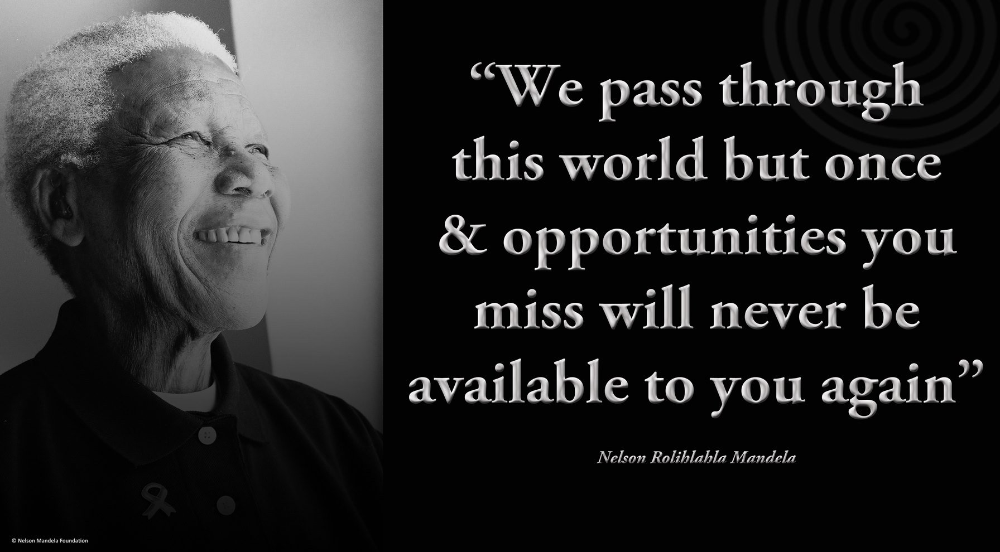
Nkosi!
Notes:
Nelson Mandela said Quote “You pass through this world once and opportunities you miss will never be available to you again.” unquote
Everyday talent managers are faced with many opportunities of making a difference, we must seize these chances of having impact

